Slide 1
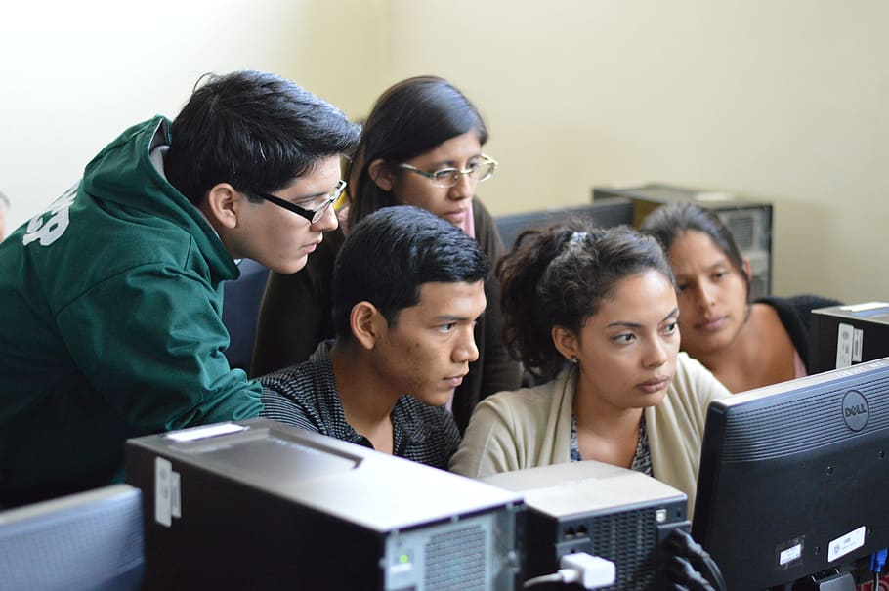
Real-time Student Assessment: Remaining on The Frontline of Your Students’ Learning:
Workshop with Peggy L. Maki
Stony Brook University
November 10, 2022
pmaki86@gmail.com

Slide 2
Discussion:
What Is Your Initial Response to This GE Assessment Report Submitted to A Mathematics Program?
Finding: “Only 33% of seniors successfully passed our GE mathematics summative assessment based on their performance on case studies.”
Recommendation: “We, therefore, recommend that the Mathematics Program provide increased opportunities for students to practice their GE mathematics skills.”
24

Slide 3

Our challenge is to humanize assessment--to uncover the challenges our currently enrolled students face in real time and then develop or identify interventions, strategies, or practices to assist each student to persist and achieve along the trajectory of each student’s educational pathway

Slide 4



Collaboratively Agreed upon Outcomes
Focused on Multiple Levels Support Development of All Students’ Enduring Learning
Institution-level
Program-level
Course- or activity-
level

Slide 5
Coherence across The Curriculum, Co-Curriculum, and
Other Educational Experiences
Students examine and compare information from various sources to evaluate reliability, validity, accuracy, timeliness, and point of view or bias. (I)
Students examine and compare information from various geological sources to evaluate reliability, validity, accuracy, timeliness, and point of view or bias. (P)
In searching a ProQuest assignment in Geology 102, students examine and compare information from various geological sources to evaluate reliability, validity, accuracy, timeliness, and point of view or bias. (C)

Slide 6
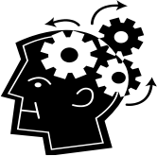
Both Agreed upon Outcomes and Assessment
Criteria Enable You to:
Monitor currently enrolled students’ equitable progress;
Provide consistent feedback to all students, holding
them accountable for their learning and future
improvements; and
Prompt students’ self-reflection on their progress, often in
the presence of a trusted “other.”
See Handouts 1 and 2

Slide 7
Real-time Student Assessment
A collaborative commitment to monitor continuously all currently enrolled students’ equitable progress toward achieving high-quality exit-level program- and institution-level outcomes. This inclusive commitment is carried out by the institution’s network of experts who identify and address patterns of underperformance in student work when they occur and as they persist along students’ undergraduate and graduate pathways.

Slide 8

    To trigger nimble and timely development of short- and longer-term practices or interventions to improve students’ learning from point of matriculation, or re-entry, to point of graduation

Slide 9
Foci:
1. Current Relevant Research on Learning That Underlies Real-time Student Assessment
2. Assessment Methods/Purposes That Enable You to Remain on the Frontline of Students’ Learning
3.The Potential Evolving Roles of Teachers and Learners in Real-time Assessment
4. Assessment Capabilities in Learning Management Systems That Provide Real-time Access to and Visual Representations of Student Performance Patterns

Slide 10
Current Relevant Research on Learning That Underlies Real-time Student Assessment
“Learning is a dynamic, ongoing process…”
(National Academies of Sciences, Engineering, and Medicine, 2018, p. 9).

Slide 11
Current Relevant Research on The Individualized
Ways in Which Humans Learn
“Learning does not happen in the same way for all individuals because they function within complex systems that affect individual learning”:
developmental
cognitive
physical
social, and
cultural systems
(National Academies of Sciences, Engineering, and Medicine. 2018. p. 2).

Slide 12
Further...
Individuals use or orchestrate various cognitive processes, skills, or techniques to learn that can either promote or hinder their learning. Thus we need to explore how they are learning or how they have learned to help them overcome underperformance patterns, such as:

Slide 13
Prior learning
Cognitive effort required to learn specific course materials
Specific cognitive processes, skills and sub-skills, tasks or sub-tasks necessary to learn or apply course material
Study or reading strategies (many students have developed routinized study or reading patterns)
Metacognitive skills

Slide 14
Discussion
Identify other stumbling blocks or learning challenges students face as they learn in a specific course or overall in a program of study?
For Example….

Slide 15
How well do your students…
Integrate
Transfer
Analyze
(Re)Apply
Re-use
Synthesize
Restructure previous incorrect learning…

Slide 16
Within a course or module or learning experience?
Along the chronology of their studies and educational experiences?
From one subject or topic or focus or context to another one, such as from an exercise, to a case study, to another course, to an internship?
See Handout 3

Slide 17
Research Necessitates We...
Continuously monitor each student’s performance patterns in real time along the trajectory of students’ learning in a course, module, or other learning experience.
Provide timely and tailored student feedback to develop self-regulated learners.

Slide 18
And, We Need to...
3. Integrate assessment into students’ learning processes, rather than separate it from their processes; and
4. Examine the efficacy of our educational practices in promoting students’ equitable progress based on real-time assessment results

Slide 19
2: Assessment Methods That Enable You to Remain on the Frontline of Students’ Learning
Predictive/
Diagnostic
Formative
Summative

Slide 20
1. Predictive or Diagnostic Assessment
Use polls, surveys, questionnaires or tasks distributed before the first course session or educational experience or during the first course session:
1.to identify students who appear to be at risk and thus will need additional support such as tutorials or may require different approaches to teaching and learning
2. to anticipate major misunder- standings or misconceptions or levels of anxiety that need to be addressed longitudinally or to identify an individual’s specific learning challenges

Slide 21
Discussion
As you look at one of your syllabi or think about a proposed course, module, or educational experience, what might you what to learn about your students both early on and along the trajectory of your course, module, or educational experience?
See Handout 4 to trigger your thinking but not to limit your responses

Slide 22
2. Formative Assessment
  Use graded or ungraded quizzes, short answers, multiple choice, fill-in-the-
  blanks, or rubrics along the trajectory of a course or module or experience:
1.to identify in real time each student’s patterns of performance and under-performance and related behaviors and then determine in collaboration with each student ways to improve under-
performance patterns-- such as routinized studying patterns (see Biwer, et als. 2020) .
2. to explore the efficacy of your educational practices, resources, and activities in promoting desired outcomes for all students--
such as the practice of
interleaving
different problem types rather
than practicing one
problem type (see MIT’s Open Learning website on slide 20 and Oaks’ work)

Slide 23
Discussion
As you look at one of your syllabi or think about a proposed course, module, or educational experience what formative assessment methods would you consider integrating to assess your students’ progress toward attaining equitable outcomes or identify effective ones you already integrate.
See Handout 5 to trigger your thinking

Slide 24
3. Summative Assessment
Use graded culminating test or authentic student work (scored with a rubric) along with student surveys or polls:
1. to draw correlations between educational practices (including revised practices), resources, or activities and students’ final performance patterns
2.to revise or redesign the next iteration of that course, module or educational experience (see Muljana, Placenia, and Luo, 2021)

Slide 25
Taxonomy of Weaknesses, Errors, or Fuzzy Thinking
Types of Weaknesses, Errors, or Fuzzy Thinking That Travel with Students | Context within Which Underperformance Patterns Occur | Identification of Interventions or Other Practices to Assist Students Overcome those Patterns
For example: conceptual, analytical, computational, procedural, grammatical, interpretive, or underperformance in recall, ability to apply to new or unfamiliar contexts, etc. | For example, inability to identify correct computational processes in lab experiments | For example, use of spaced learning strategy to provide students multiple opportunities before lab experiments to practice computational processes (See MIT on slide 20)

Slide 26
Four Major Resources to Build Teaching, Learning, and Assessment Strategies to Address Students’ Diverse Learning Needs
Open Educational Resources sites (OER)
2. MIT Website that Reports Research Findings about Teaching and Learning: MIT’s Open Learning website, “Research-Based Learning Findings” (openlearning.mit.edu)
3. Oakley, Rogowsky, and Sejnowski’s book based on brain science: Uncommon Sense Teaching. TarcherPerigee, an Imprint of Penguin Random House
4. Student-led Peer Review. See Lowe, A., Cummins, L., Clark, S., Porter, B., and Spitz, L. (2022). Student-Led Peer Review: A Practical Guide to Implementation Across Disciplines and Modalities. Sterling, VA: Stylus Publishing, LLC

Slide 27
3. The Potential Evolving Roles of Teachers and Learners in Real-time Assessment
Adaptive, Evidence- and Research- informed Educators
Reflective, Self-regulated
Learners
Evidence

Slide 28
Provides Educators Increased Insight into The….
Real-time challenges or obstacles an individual student confronts while learning or applying new material that hinder students’ equitable progress
Efficacy of educational practices in promoting student learning—for example, pedagogy, resources, types of interventions
New knowledge or skills students acquire along the progression of each course or educational experience

Slide 29
Timely Feedback in the “dynamic, ongoing process of learning” Assists Currently Enrolled Students to:
equitably progress toward attaining high quality exit-level course-, program-, and institution-level outcomes by closing underperformance gaps when they occur and as they persist in real-time
2. become self-regulated learners who-- with the guidance of “a trusted other”-- develop agency for their learning by identifying the causes of underperformance patterns, developing strategies to improve them, and assuming responsibility for continued improvement.

Slide 30
Possible Approaches to Taking RTSA to Scale
Identify High-Risk Courses or Modules That Stretch Across Students’ Degree Pathways, From Point of Matriculation, Transfer, or Re-entry Into Higher Education to Point of Graduation
Identify High-Risk Learning Outcomes
Initially Reduce Intervals of Time Between Current Assessment Reporting Times to Identify and Improve Longitudinally Your Enrolled Students’ Chronological Barriers

Slide 31
Identify and Then Track the Most Vulnerable Cohorts of Students
Initially, Assess Students’ Near-Graduation Work to Identify Patterns of Underperformance That Need to Be Addressed Longitudinally
Learn How Colleagues in Specialized or Nationally Accredited Programs Continuously Assess Their Students’ Progress and Use Results to Advance Enrolled Students to increasingly higher levels of performance
See Handout 6: An Example of Continuous Assessment of Student Learning in A Program

Slide 32
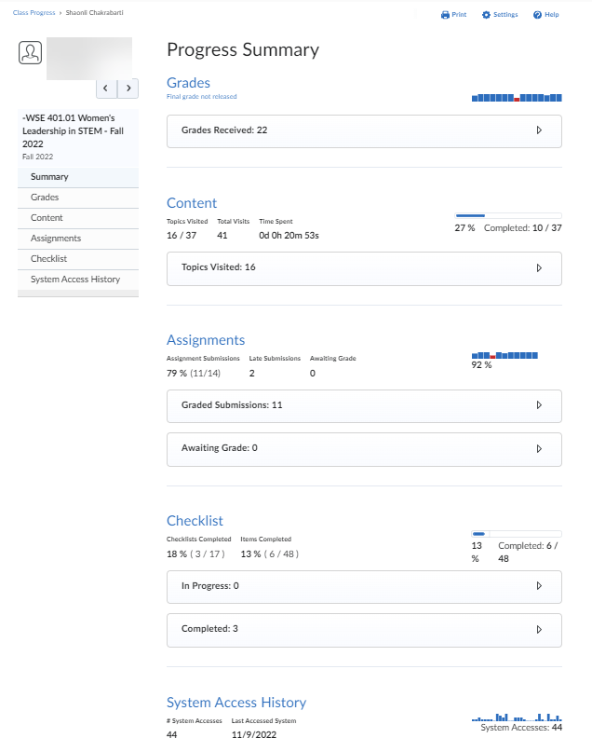
4. Assessment Capabilities in Learning Management Systems That Provide Real-time Access to and Visual Representations of Student Performance Patterns
Weekly Dashboard Report on Student’s Online Activity from a Stony Brook Brightspace course
Used with permission from Canvas

Slide 33
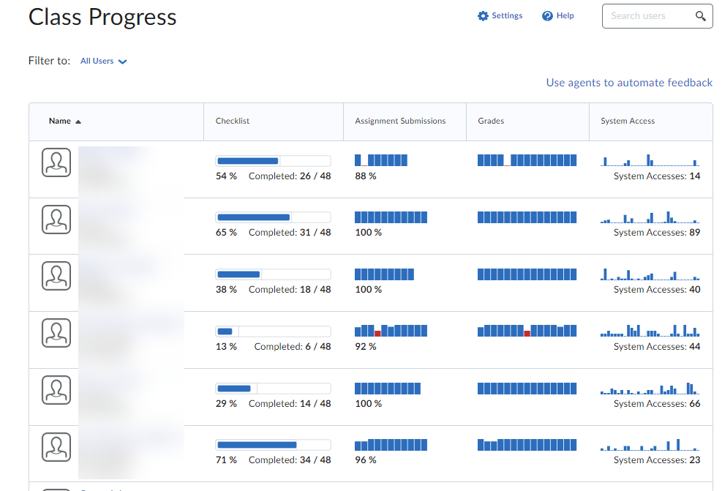

Slide 34
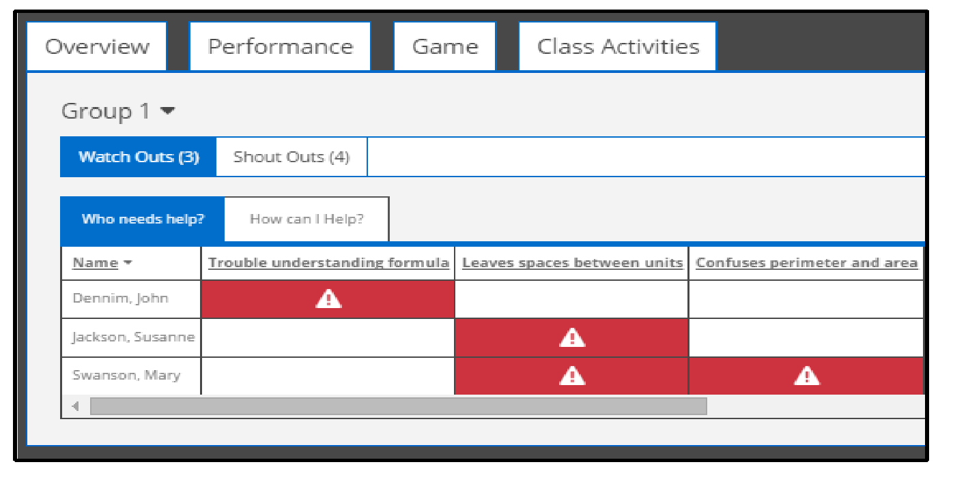
Faculty Dashboard Identifying Student Performance on a Math Quiz (courseware) Contributed by DiCerbo

Slide 35
Works Cited
Biwer, F.,Mirjam G.A. Egbrink, Aalten, P., and de Bruin. 2020, June 2. “Fostering Effective Learning Strategies in Higher Education—a Mixed Methods Study. Journal of Applied Research in Memory and Cognition .Available at: https://doi.org/10.1016/j.jarmac.2020.03.004
Canvas.com
DiCerbo, K. (2017). Example of Some Criteria on a Faculty Dashboard for a Mathematics Course in Maki, P. Real-time Student Assessment. Sterling, VA: Stylus Publishing, p.146.
Muljana, P.S., Placenia,G.V., and Luo, T. (2021). “applying a Learning Analytics Approach to Improve Course Achievement.” In Maki, P. and Shea, P.. Eds. Transforming Digital Learning and Assessment, Sterling, VA: Stylus Publishing, LLC, pp. 143-179.
National Academies of Sciences, Engineering, and Medicine. (2018.) How People Learn II: Learners, Contexts, and Cultures. Washington, D.C.: National Academies Press.

Slide 36
Some Related Resources on Teaching, Learning, and Assessing Learning
Maki, P. (2021). “ The Evolving Landscape of 21st Century Learning Technologies,” in Maki, P. and Shea, P. Transforming Digital Learning and Assessment: A Guide to Available and Emerging Practices and Building Institutional Consensus. Sterling, VA: Stylus Publishing, LLC., pp. 21-82.
MIT’s Open Learning Website: openlearning.mit.edu (make sure you look under “research.”
Oakley, B., Rogowsky, B., and Sejnowsky,T. (2021). Uncommon Sense Teaching. TarcherPerigee, an Imprint of Penguin Random House
Open Educational Resources sites (OERs)

